Slide 1

A lesson of Physical Computing with Scratch: RPi, scratchClient and Arduino
Presentation for Pi And More 10
Trier – 2017/06/24
Hans de Jong

Slide 2

Weekendschool
Generally parents tell their children: “Learn for later”. But what is later?
“I want to become an engineer. Do you maybe know an engineer? I would very much like to meet one”
EINDHOVEN
58 students
IMC Weekendschool
Trudo Weekendschool
2

Slide 3
Weekendschool
Goal and way of working
Bridge the gap between school and what is needed to live in society
  Which is in more privileged families provided by the family
Don’t abandon them at the end: Alumni program
Data shows: alumni have better professional prospects, are more self-aware, and feel more connected with society.
Program includes training in presentation, research, debate, and conflict resolution – an allround character education.
Some numbers
> 1000 students in 2016 between 10 and 14 years of age
From disadvantaged neighbourhoods
3500+ volunteers
Funded by 110+ sponsors (companies, individuals, foundations – not central government)
Curriculum lasts for 2.5 to 3 years
Over 2100 alumni
Students are selected on motivation, not on IQ
IMC Weekendschool was founded in 1998, Trudo Weekendschool in 2009
IMC Weekendschool has inspired 30+ other independent copy projects in The Netherlands (one of which is the Trudo Weekendschool).
Classes provided
Art
Medicine
Law
Philosophy
Astronomy
Politics
Mathematics
Physics
Programming
Electro
Film
Architecture
Language & Poetry
Entrepreneur
Safety
Energy
Journalism
… many more
More information
www.imcweekendschool.nl
www.trudoweekendschool.nl
3

Slide 4
Curriculum of Programming
Objectives
Learn how to use keyboard, mouse and screen without causing health problems.
Learn how to make programs in Scratch
Learn that programming is about more than changing pixels on a screen, so also do Physical Programming.
Learn something about professional programming.
Build something tangible that can be taken home.
Let the children experience how powerful and joyful programming is.
3 - 5 Weekendschool days
Each is 2x 75 minutes with 30 minutes lunch break inbetween
3 days given to Weekendschool 2nd graders: 11 years old.
2 days given to Weekendschool 3rd graders: 12 years old.
4

Slide 5
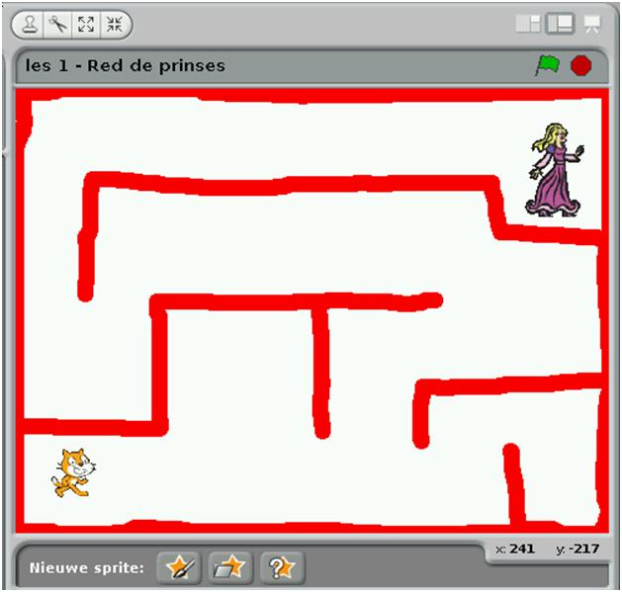
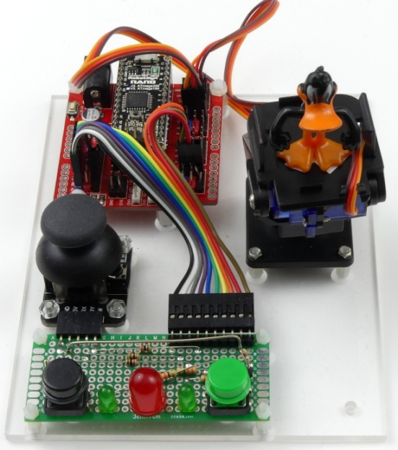
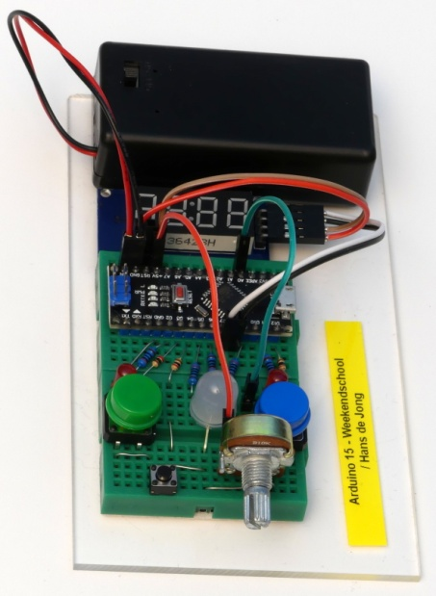
The 3 lessons of the curriculum
Lesson 1 (day 1 and part of 2)
Program a game in Scratch, output on monitor.
1 helper per 4 to 8 students.
Max. 60 students per class.
Lesson 2 (part of day 2 and day 3)
Physical computing controlled from Scratch.
1 helper per 4 students.
Max. 60 students per class.
Lesson 3 (day 4 and 5)
Program an Arduino Nano from RPi.
Build the electronic circuit of a game to be able to take it home.
1 helper per 2 students.
Max. 30 students per class.
5

Slide 6

USB connection to Raspberry Pi (optionally via a powered USB Hub)
9 Volt power
(power of Raspberry Pi is too limited, and cheap microUSB cables cannot transport high current)
Duck on a pan/tilt platform to demonstrate the use of servos
Arduino Nano with 328p processor
Extension board
(handy connections with 3 pins per GPIO (VCC, GND and signal) to connect servos, power regulator)
Buttons and LEDs to demonstrate digital input / output
Joystick to demonstrate analog input
6

Slide 7
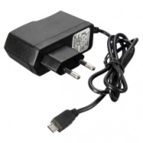
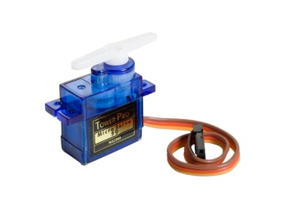
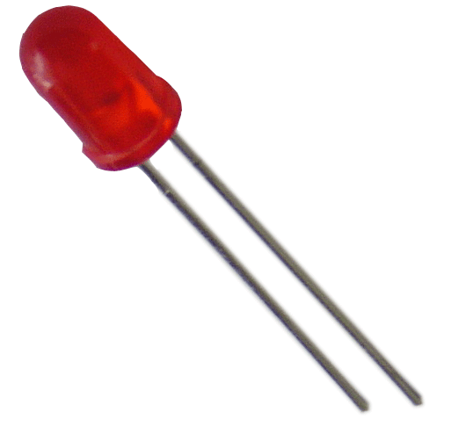
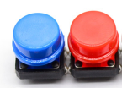


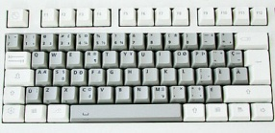
The setup
Raspberry Pi
2B or 3B
Powered USB hub
(not strictly needed since Arduino is powered separately – used for protection of RPi)
Arduino Nano
Scratch 1.4 run time
scratchClient
scratchClient Sketch
Remote Sensor Protocol Over socket 42001
Global variables
Broadcasts
Program in Scratch
Predefined sprites (with some code, sounds and costumes)
scratchClient Config file
Defines function of the GPIO pins on the Arduino (and RPi) and gives them logical names.
Standard setup
Programmed by the students
Prepared by the teacher
7

Slide 8
The game
Start the game by pressing the joy stick button (because it is there anyway)
Red LED lites at random
When LED lites, the first one pressing their button gets a point
  The duck turns to the person scoring and makes a bow.
When the button is pressed without the LED being lit, the other gets a point
  The duck turns to the one who pressed and shakes “no”.
8

Slide 9
Demo of the game
Have a look at
https://www.youtube.com/watch?v=Qo1gnXNzhqE
9

Slide 10
Why using an Arduino* for GPIO rather than the GPIO of Raspberry Pi?
Arduino provides analog inputs.
Arduino provides hardware PWM (Pulse Width Modulation), which makes controlling servos more stable.
Arduino can support real time protocols (e.g. for controlling WS2812).
Arduino GPIO pins are 5V tolerant.
When making mistakes, blowing up an Arduino Nano is less costly (< 2.5 euro for a clone) than damaging a Raspberry Pi.
When needing more GPIO pins, extra Arduinos can be added.
  scratchClient supports this as beta.
Easier setup and tear down in temporary classroom situations
  Only needing to plug/unplug USB and power connectors.
  Can be programmed to steer servos automatically to default position, ready for packing up.
* Arduino Nano or Arduino Uno can be used
10

Slide 11
scratchClient: things to know
Installing
Download scratchClient
  http://heppg.de/ikg/wordpress/?page_id=6
Unpack
Install other packages as described on the download page
Adapt the config file for Arduino Uno (which is used for Nano as well)
  NEW: A good UI is now available, so now very easy to do.
Use the Arduino IDE to program the scratchClient sketch in the Arduino
  Note: I have experienced problems when loading sketches via a USB hub. Works fine without.
Using
Start scratchClient with the correct config file as parameter.
Help?
Everything is described in the excellent documentation.
11

Slide 12
Cost and effort for the board
See Bill of Material on the next slide.
Material cost for a single piece: ca. 20 euro, but you will get spare material for that amount.
Material cost for a series for e.g. a school: can get sub 20 euro.
Labour content (no compensation included in the cost): ca. 2.5 hour.
Most components were ordered from Aliexpress.com.
  Benefits
    Extremely low prices.
    Almost always shipped for free to The Netherlands, Germany and probably other EU countries.
      Counterintuitive: the smaller the order, the more chance that there are no shipment costs.
  Disadvantage
    Never any data sheet and hardly ever precise specs.
      So you will need to Google and find other sources. And sometimes just buy and try.
    Delivery takes between 2 weeks and 2 months
      Or arrives never (some 2% of shipments), but then refund is promptly provided.
    Especially for power supplies: do not expect more than 50% of output current that is rated.
      Otherwise it will overheat and blow up. Or the voltage drops way below what is needed.
    Occasionally products are quickly running out
      So make sure you order quickly the amount you need and some spare for the future.
  Note: limit each order to max 22 euro (holds for all of the EU) if you want to avoid VAT, import duties and handling costs at the shipping company.
  Secure payment possible (at least in The Netherlands: you can use IDEAL).
12

Slide 13
BoM (Bill of Material)
The URLs are in the Excel file on github. See slide 16.
13

Slide 14
What can scratchClient do?
Control pins on Arduino Uno / Nano for Digital In, Digital Out, Analog In, PWM (Pulse Width Modulation).
  NEW: Counter function (counting pulses from e.g. IR speed detector)
As well control all the GPIO pins on Raspberry Pi.
  NEW: Control Sonic Pi, Minecraft, MQTT, Scroll Phat HD, Micro Dot Phat, Lirc IR remote controls
Allow peripherals be addressed by comprehensible names rather than pin numbers.
Run on a Windows PC and in combination with Arduino provide physical computing to Scratch running on Windows.
Monitor the hardware state from a browser, simulate hardware signals in the browser.
Monitor hardware state of all workplaces from a central Windows PC.
Allows to use predefined configurations for experiments, which makes setup in a classroom very easy.
  Minimizing the trouble with I/O configuration.
Keep apart multiple connected Arduinos and address the right GPIO pins on the correct Nano
  So the number of connectable peripherals is virtually infinite.
My conclusion:
scratchClient is the ideal software to bring physical computing to Scratch!
14

Slide 15
Announcement …
Within a few weeks, scratchClient will also support Scratch 2
  In addition to Scratch 1.4
Scratch 2 runs via a browser on Windows PC or RPi
  So not stand alone
15

Slide 16
Try for yourself?
Attend my beginners workshop at 13.30 today and/or the advanced workshop at 16.00
  You can there try it out for yourself (2 people per workplace setup)
  Please drop by in the workshop room HZ203 to register
  Space is limited.
Workshop will be in English (presentation, material, support)
There will be German spoken support in addition to English
  Gerhard Hepp, author of scratchClient, will be present.
You will learn how to configure scratchClient, control hardware from Scratch, build up a test board and – if you want – take a look at the game.
  See the program flyer or ask me after the presentation for more information.
16

Slide 17
More information
This presentation, source files of the game and workshop material
  www.github.com and search for Weekendschool or for PiAndMore
scratchClient
  http://heppg.de/ikg/wordpress/?page_id=6
Scratch
  https://scratch.mit.edu/
Scratch on Raspberry Pi
  https://www.raspberrypi.org/forums/viewforum.php?f=77
Raspberry Pi
  https://www.raspberrypi.org/
Arduino
  https://www.arduino.cc/
17

Slide 18
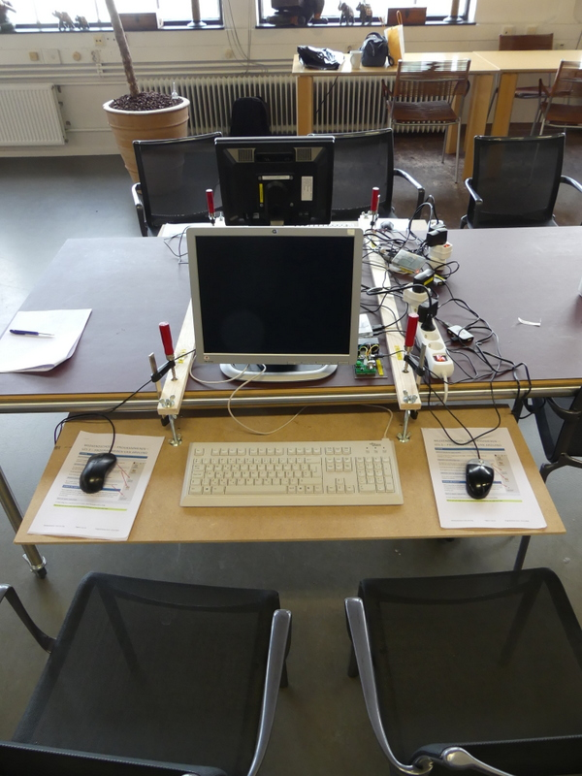
Making a workplace for 2 students
Raspberry Pi 3B
  With power supply
  With 16 GB microSD card
Second hand monitor HP1750 or HP1740
Second hand keyboard
Second hand mice (2x)
  so students can each use a mouse and can be instructed: learn to use your left hand for the mouse as well.
MDF 9 mm board (better: 2x 4 mm with 12 mm filler in between)
  See further the pictures
For 2 workplaces opposite of each other: 2 laths, 4 clamps, 4 threaded rods M8, 4 nuts, 16 large washers, 12 butterfly nuts.
84 liter crates of RUB (Really Useful Boxes) can very precisely contain 4 monitors
  2 monitors dismounted from their pedestal
  Can in addition hold mice and cables.
  http://www.reallyusefulproducts.co.uk/
Ergonomics: keyboard at the correct height to teach children to pay attention to how they sit when using computers to avoid medical problems (RSI) later in life.
18

Slide 19
Questions?
19

